Slide 1
Peripheral Neuropathy, Chemotherapy & You
Peter Argenta, MD

Slide 2
Definition
The conditions that result when nerves that carry messages to and from the brain and spinal cord from and to the rest of the body are damaged or diseased.
What does it mean for patients?
Numbness, tingling (“asleep”), burning, pain, weakness
Drops, falls, trips, disability

Slide 3
NeurO-Anatomy (In Box form)
Muscle Movement
Balance
Autonomic Control
BRAIN
SPINE
PERIPHERY
Heat/Cold
Pressure
Proprioception

Slide 4
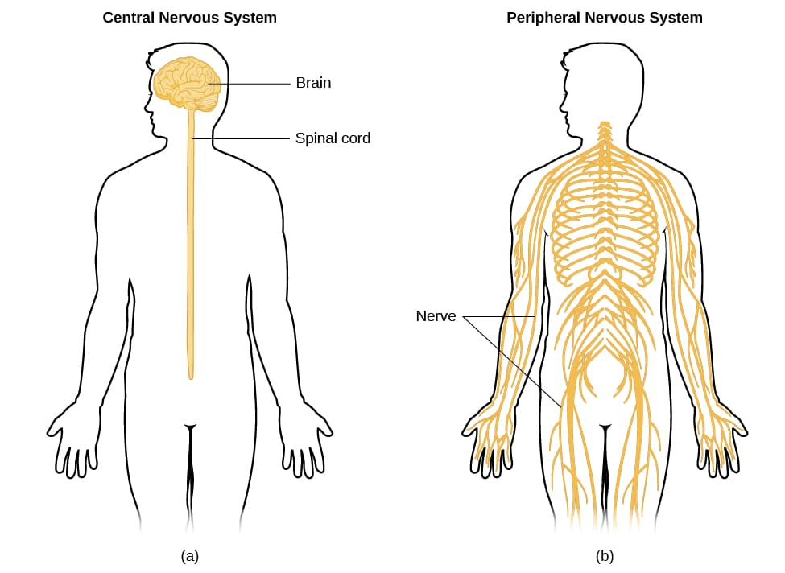
Neuro-Anatomy (schematic form)
Definition:

Slide 5
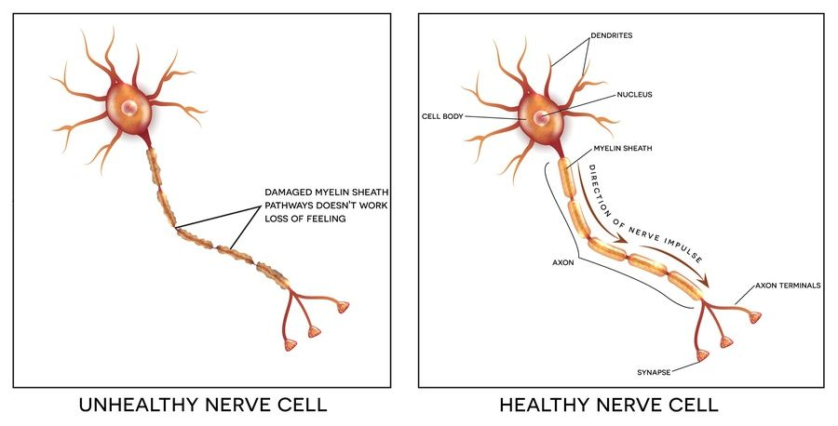
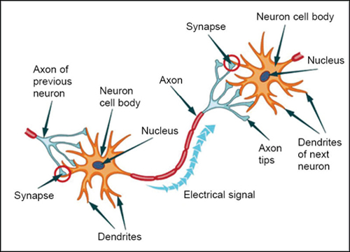
Neuro-Anatomy (Cellular) – last one, I promise

Slide 6
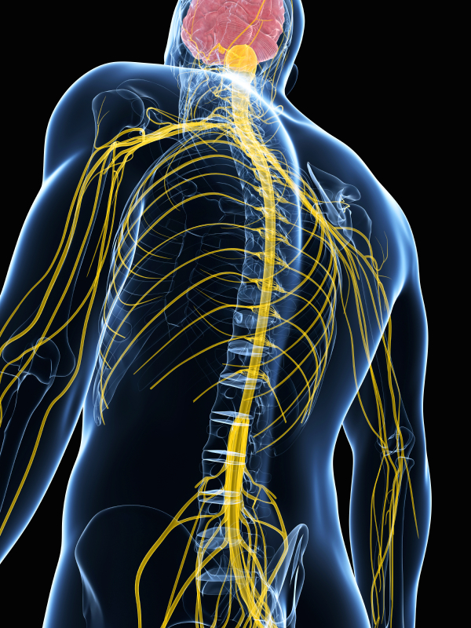
Brain
Intoxication
Stroke
Tumor
Pressure
Invasion
Trauma
MS
Other
Alzheimers
Places things can go wrong
Spine/Junctions
Stroke
Tumor
Pressure
Invasion
Trauma
ALS
MS
Periphery
Diabetes
Chemo
Poisons
Cold
Age

Slide 7
Chemotherapy-Induced Peripheral Neuropathy (CIPN)
Agents
Taxol (but not taxotere), Cisplatin (but not carboplatin), Vinca
How do they affect
Unknown
Not all equal
Progressive/Cumulative

Slide 8
How does CIPN happen
Reduce dendrite number or length
So…..
Which one(s) is it?
Metabolic health
Insulation problem
And…..
Can it be fixed?
Impaired/Absent neurotransmitter

Slide 9
Chemotherapy-Induced Peripheral Neuropathy (CIPN)
Model 1

Slide 10
Chemotherapy-Induced Peripheral Neuropathy (CIPN)
Model 1
END RESULT
Message is “heard”
“Phone lines” are out!

Slide 11
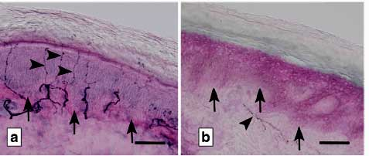
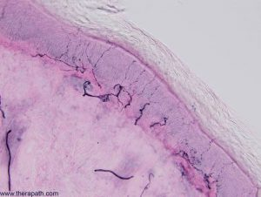
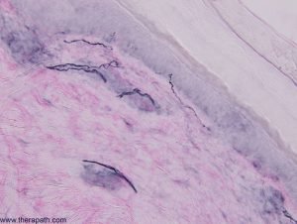
Chemotherapy-Induced Peripheral Neuropathy (CIPN)
Model 2 – nerve withdrawl

Slide 12
Chemotherapy-Induced Peripheral Neuropathy (CIPN)
Model 2 – nerve withdrawal
Different areas = different nerve density
Nerve density correlates with neuropathy scores
….imperfectly
In diabetics

Slide 13
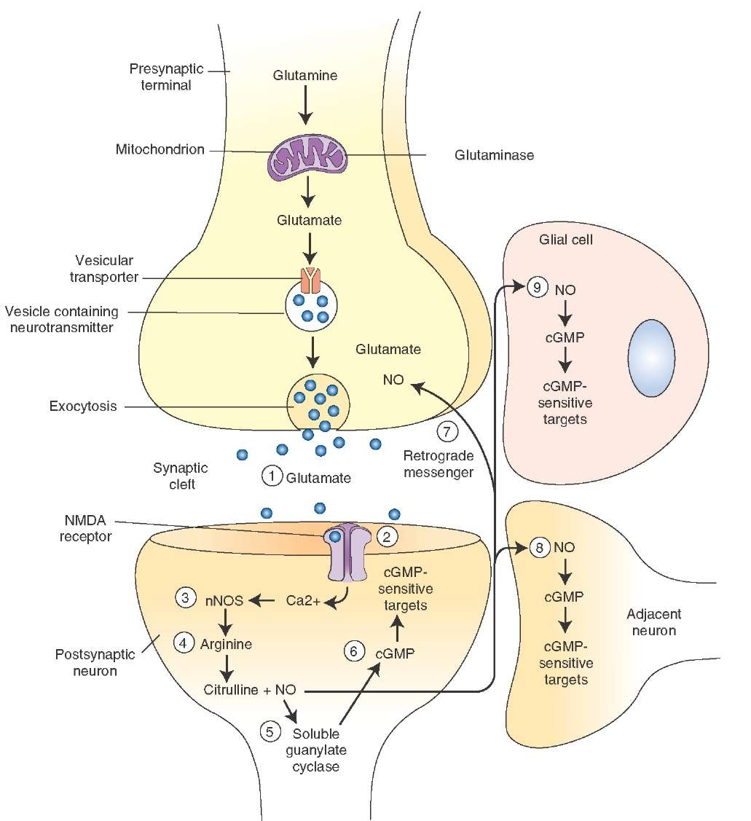
Chemotherapy-Induced Peripheral Neuropathy (CIPN)
Model 3

Slide 14
So what are you going to do about it?
Treatment options with universal success?
1.

Slide 15
Treatment OPTIONS– Mixed success
Pharmacy
Gabapentin (anti-epileptic)
Duloxetine (SSRI)
Supplements
L-glutamine
B6
Alternatives
Acupuncture
Light/PBM
Gabapentin
Approved for seizure and post-herpetic neuralgia
MOA unknown – “nerve calming”
Duloxetine (SSRI)
Only phase III data
Approved for painful neuropathy

Slide 16
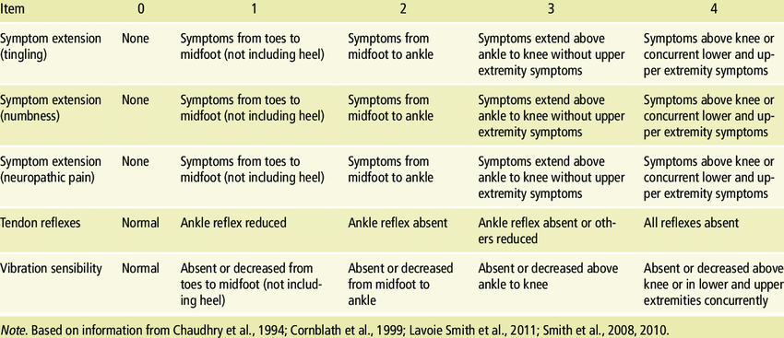
Why is there no easy treatment
It is hard to quantitate success
….a little less numb?
>30 tools for measuring neuropathy
No consensus on best
Most attempt to objectify the subjective
Redundancy makes small changes difficult to detect
Hard to control for confounding variables
Age, smoking, diabetes, exposures

Slide 17
So…What should I use?
Supplements (B-complex or L-glutamine)
1. Cheap and safe
2. Used as controls in most studies
Neuromodulating agents (gabapentin, SSRI)
1. Best studied*, well tolerated*, approved
2. May have beneficial side effects
Duloxetine*
231 pt placebo-controlled RCT
Primary outcome is Pain Score
1 point reduction in 10 point scale vs 0.3 point reduction in placebo
10% drop-out from toxicity

Slide 19
Peripheral Neuropathy
Current Treatments
Not disease specific
Not effective
B-complex, L-glutamine, Gabapentin, Duloxetine*
231 pt placebo-controlled RCT
Primary outcome is Pain Score
1 point reduction in 10 point scale vs 0.3 point reduction in placebo
10% drop-out from toxicity
Autonomic dysfunction is also common
Dysregulated sweating
Dysregulated heart rhythms

Slide 20
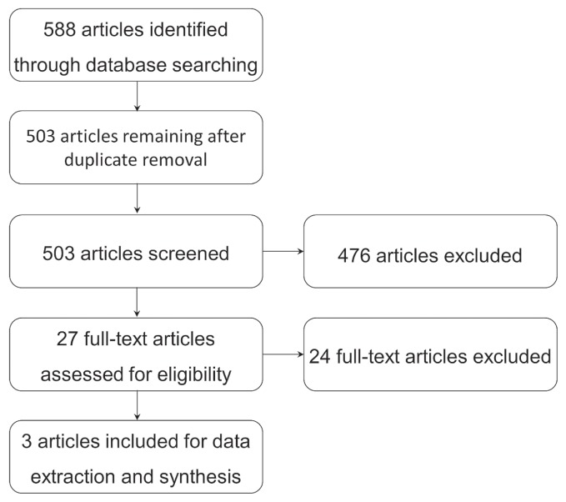
So…What should I use
Acupuncture
- “been around”, safe, cheap?
- lots of single-arm data
- three RCTs
Needed
Accupuncture
CIPN
A control
Results
Li. Et al Curr Oncology 4/2019

Slide 21
Acupuncture
Definition:
Rostock et al., 2013²⁹ | 59 | Men and women | Not specified | Taxanes, platinum derivatives, or vinca alkaloids | Electroacupuncture | Three groups:■ Hydroelectric baths ■ Vitamin B complex capsules ■ Placebo (lactose) capsules | 2–3 Times weekly for 3 weeks (total of 8 sessions)
 | Outcomes assessed:■ Primary: patient-reported CIPN severity (score on the numerical rating scale for neuropathic symptoms) ■ Secondary: neuropathy score, electroneurography, Common Toxicity Criteriaª, QLQ-C30^{b}
 | Results: Acupuncture no more effective than control treatments: no significant difference in outcome improvement (primary or secondary) between acupuncture group and control groups.
Lu et al., 2017³¹ | 40 | Women | Breast cancer, stages I–III | Not specified | Acupuncture | Low-dose acupuncture, delayed 8 weeks after intervention | 2–3 Times weekly for 8 weeks (total of 18 sessions) | 1–2 Times weekly for 8 weeks (total of 9 sessions)
 | Outcomes assessed: Degree of CIPN using the PNQ, FACT-Ntx^{c}, QLQ-CIPN20^{b}
 | Results: Acupuncture better than low-dose acupuncture for CIPN: significant improvement compared with control on the PNQ (p=0.02), the FACT-Ntx (p=0.002), and the QLQ-CIPN20 (p=0.006)

Slide 22
Acupuncture
Definition:
Han et al., 2017³⁰ | 104 | Men and women | Multiple myeloma, all stages | All chemotherapy treatments | Acupuncture and methylcobalamin | Methylcobalamin | Approximately 3 times weekly for 12 weeks | Every other day or daily for 12 weeks
 | Outcomes assessed: Degree of CIPN using VAS pain scores, score on the FACT/GOG-Ntx^{c} , and nerve conduction velocities
 | Results: Compared with methylcobalamin, acupuncture was effective for CIPN: significant decrease in VAS pain scores (p<0.01), and FACT/GOG-Ntx scores (p<0.05); no significant difference in nerve conduction velocities between acupuncture and controls (p>0.05)

Slide 23
Acupuncture
Definition:
Rostock et al., 2013²⁹ | 59 | Men and women | Not specified | Taxanes, platinum derivatives, or vinca alkaloids | Electroacupuncture | Three groups:■ Hydroelectric baths ■ Vitamin B complex capsules ■ Placebo (lactose) capsules | 2–3 Times weekly for 3 weeks (total of 8 sessions)
 | Outcomes assessed:■ Primary: patient-reported CIPN severity (score on the numerical rating scale for neuropathic symptoms) ■ Secondary: neuropathy score, electroneurography, Common Toxicity Criteriaª, QLQ-C30^{b}
 | Results: Acupuncture no more effective than control treatments: no significant difference in outcome improvement (primary or secondary) between acupuncture group and control groups.

Slide 24
Acupuncture
Conclusions:
“Although two of three included studies showed efficacy, it is difficult to offer a strong recommendation for the use of acupuncture in cipn because of limited data and sample sizes…. Given that the quality and quantity of the literature concerning this topic are limited, a potentially beneficial effect might exist, but future rigorous rcts with appropriate controls should be conducted.”

Slide 25
Photobiomodulation
Low level, non-ionizing laser light therapy
Preclinical – increases cellular/mitochondrial respiration, increases NO, ATP production
Animal models
Reduces oxaliplatin-induced mechanical and cold allodynia
Improves neural regeneration and conduction post crush injury
Increased microcirculation
Human (sham-controlled)
improved weekly pain scores among patients with diabetic sensory-motor polyneuropathy
Improved carpal tunnel associated neuropathy

Slide 26
Our trial

Slide 27
Our trial

Slide 28
Our trial
Patients
Any patient with self-identified peripheral neuropathy, not in active treatment
Treatments
PBM vs placebo 3x/week for 6 weeks
No new treatment (but could continue any you were on)
Measures/Outcomes
Modified Total Neuropathy Score (mTNS)
Primary outcome - ∆mTNS at 8 weeks

Slide 29
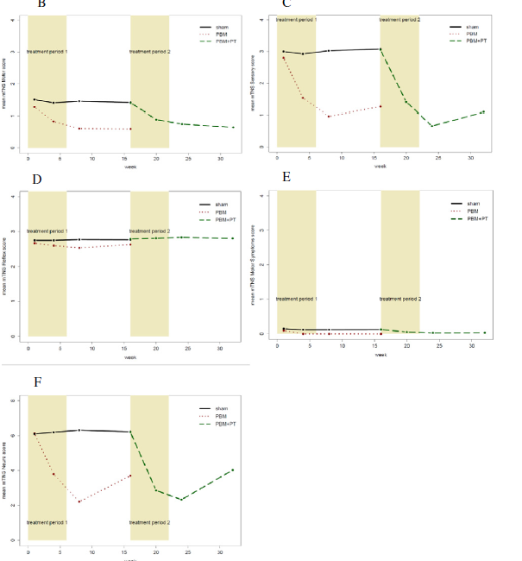
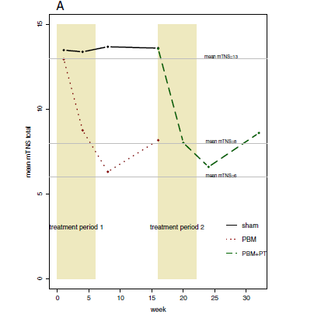
Our trial
Outcomes: Primary
Primary - -6.8 points drop in mTNS (-53%, p<0.001) vs +0.2 (+1.5%) in placebo arm (p=.44)
Cross-over patients (38/40) - -6.9 points (-51%, p<0.001)
Outcomes: Secondary
Rapid and sustained improvement , but with some regression*
Unequal distribution within the mTNS*
Outcomes exploratory
No difference in outcomes between early (<7 months post chemo) or late exposure (-6.7 and -6.9 respectively)
Patients with greater (> mean baseline mTNS) had more improvement
B – motor, strength
C - sensory symptoms
D - reflexes
E – motor symptoms
F - sensory detection

Slide 30
What’s Next
PBM
How does it work?
What is optimal dosing?
How much, how long, maintenance?
Can it be used as a preventative?

Slide 31
